Slide 1

6th Grade Math
Unit 8, Lesson 1 Area of Triangles - Part 1 Volume 2, pg. 75

Slide 2


Benchmark
MA.6.GR.2.1
Derive a formula for the area of a right triangle using a rectangle. Apply a formula to find the area of a triangle.
volume 2, pg. 75

Slide 3
Integrated Mathematical Thinking and Reasoning Standards
MA.K12.MTR.1.1 Actively participate in effortful learning both individually and collectively.
MA.K12.MTR.2.1 Demonstrate understanding by representing problems in multiple ways.
MA.K12.MTR.4.1 Engage in discussions that reflect on the mathematical thinking of self and others.
MA.K12.MTR.5.1 Use patterns and structure to help understand and connect mathematical concepts.
volume 2, pg. 75

Slide 4

Learning Target
I can discover the formula for the area of a triangle.
volume 2, pg. 75

Slide 5

Warm-Up
volume 2, pg. 75

Slide 6
8.1.1 Warm-Up: The Importance of Struggle
When learning something new, whether it is a sport, a musical instrument, or even math, you may experience failure before you experience success. The key is to keep going even when you make mistakes. Learning takes place during the time you practice and during the time you struggle.
Which choice would you feel less comfortable doing?
Answering a question and getting it wrong.
Saying, “I do not know,” as your answer to a question.
volume 2, pg. 75

Slide 7
Describe a time that you persevered when learning something new.
When you persevered in learning, how did you overcome any initial fear(s)?
volume 2, pg. 75

Slide 8

Exploration
volume 2, pg. 76

Slide 9

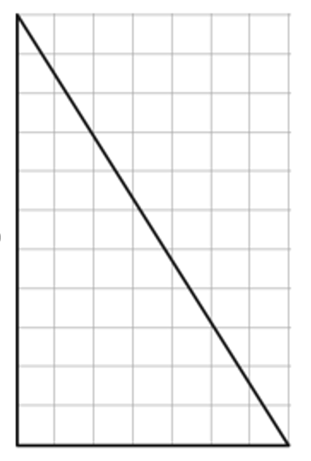
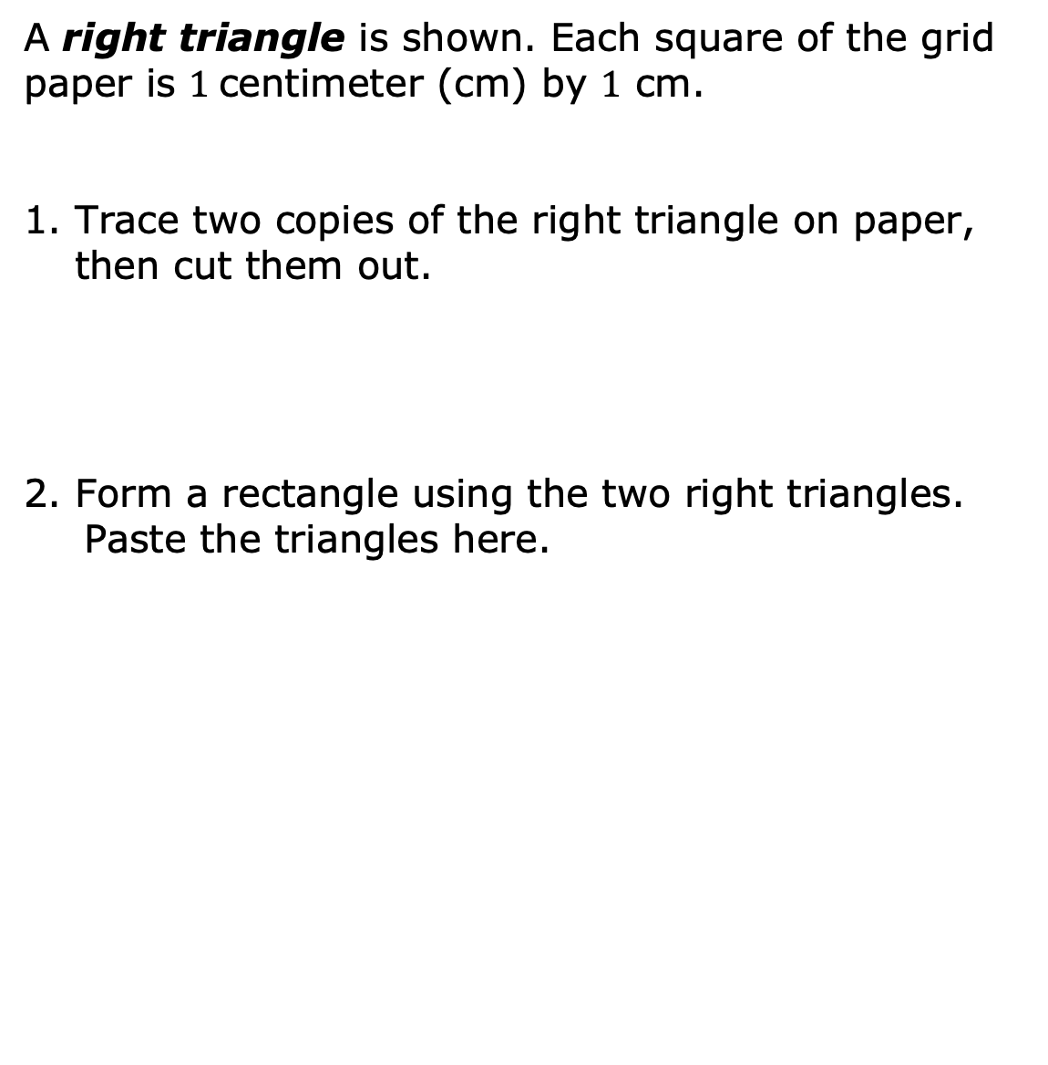
8.1.2 Exploration: Discovering the Area of a Right Triangle
A right triangle is shown. Each square of the grid paper is $1$centimeter (cm) by $1$ cm.
Trace two copies of the right triangle on paper, then cut them out.
2. Form a rectangle using the two right triangles. Paste the triangles here.
volume 2, pg. 76

Slide 10
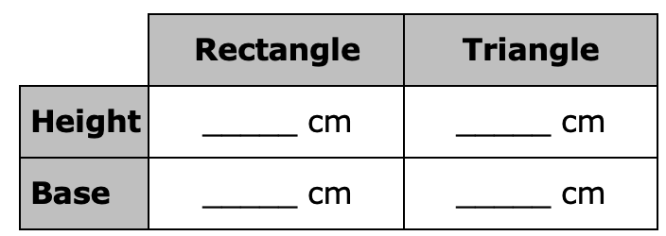
3. Using the image just created, complete the table.
volume 2, pg. 76

Slide 11
What is the area of the rectangle? Include units.
Describe the relationship between the area of one right triangle and the area of the rectangle.
volume 2, pg. 76

Slide 12
What is the formula for the area of a rectangle?
Use the relationship observed and the formula for the area of a rectangle to write a formula that can be used to find the area of a right triangle.
volume 2, pg. 76

Slide 13

Collaboration
volume 2, pg. 77

Slide 14

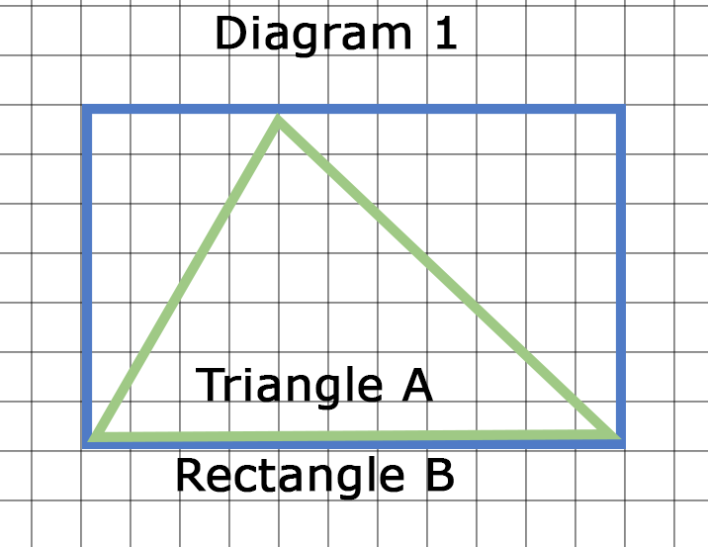

8.1.3 Collaboration: Area of an Acute and an Obtuse Triangle
An acute triangle is shown. Each square of the grid paper in Diagram 1 and Diagram 2 is $1$centimeter (cm) by $1$ cm.
Rectangle B is drawn around acute Triangle A, as shown.
volume 2, pg. 77

Slide 15
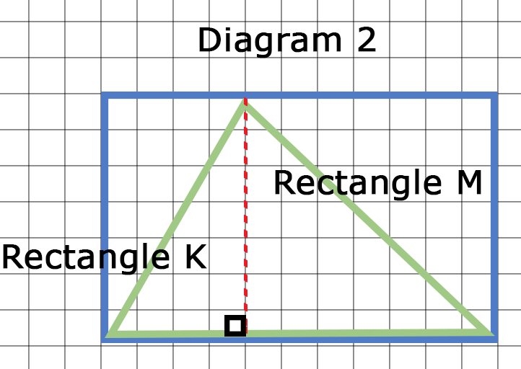
The height of acute Triangle A is shown as a dashed red line. It divides Rectangle B into two smaller rectangles,
Rectangle K and Rectangle M, and divides Triangle A into two smaller right triangles.
volume 2, pg. 77

Slide 16
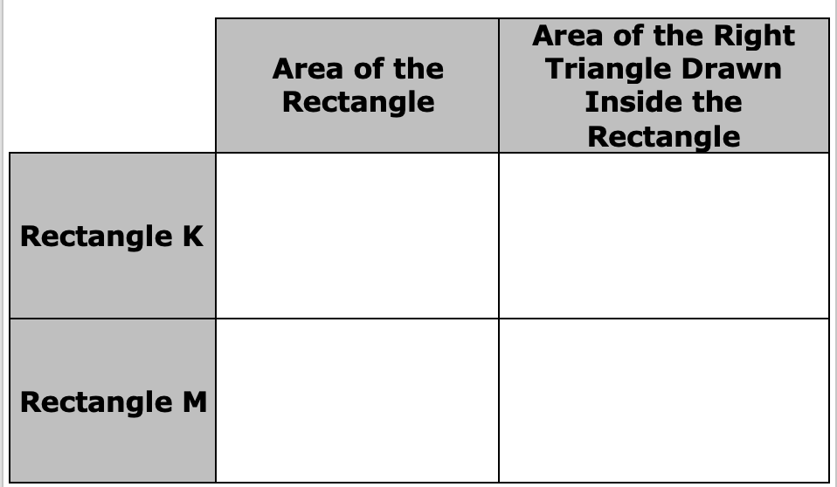
Use the two diagrams to complete the table.
volume 2, pg. 77

Slide 17
The area of acute Triangle A is equal to the sum of the right triangle inscribed in Rectangle K and the right triangle inscribed in Rectangle M.
What is the area of acute Triangle A?
What is the area of Rectangle B?
What is the relationship between the area of Rectangle B and the area of acute Triangle A?
volume 2, pg. 77

Slide 18
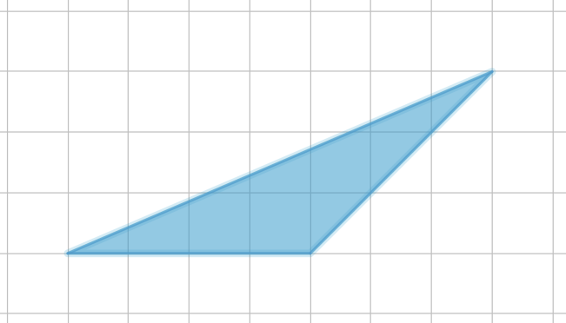
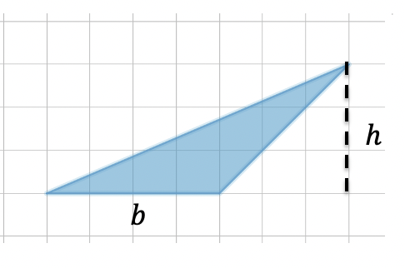
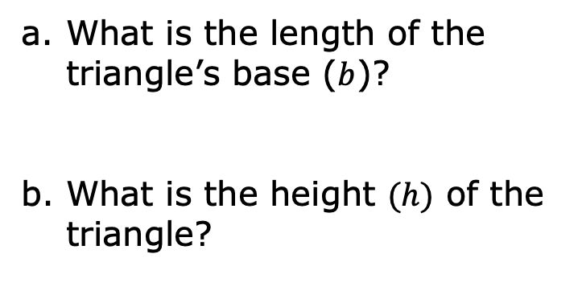

An obtuse triangle is shown. Each square of the grid paper is $1$ centimeter (cm) by $1$ cm.
What is the length of the triangle’s base ($b$)?
What is the height $(h)$ of the triangle?
volume 2, pg. 78

Slide 19
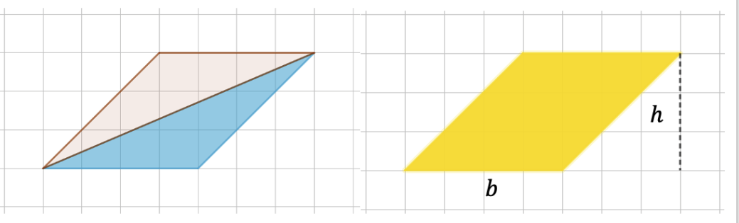
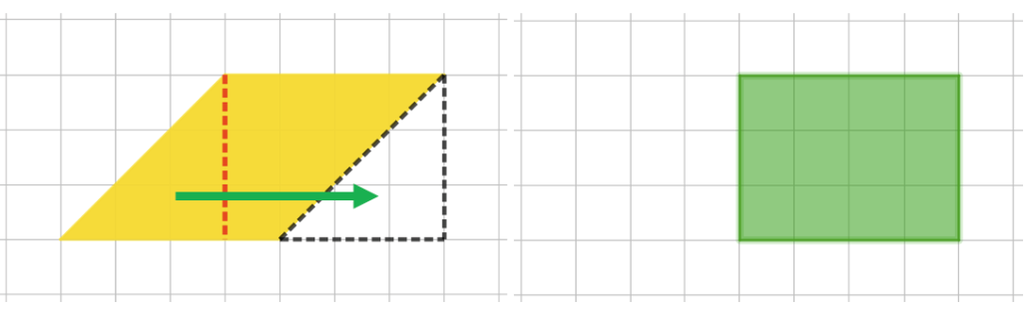

A copy of the triangle is made, and the two triangles are arranged to form a parallelogram with a base of $4$ cm and a height of $3$ cm, as shown.
The parallelogram is then decomposed, and the parts are rearranged to form a rectangle.
volume 2, pg. 78

Slide 20
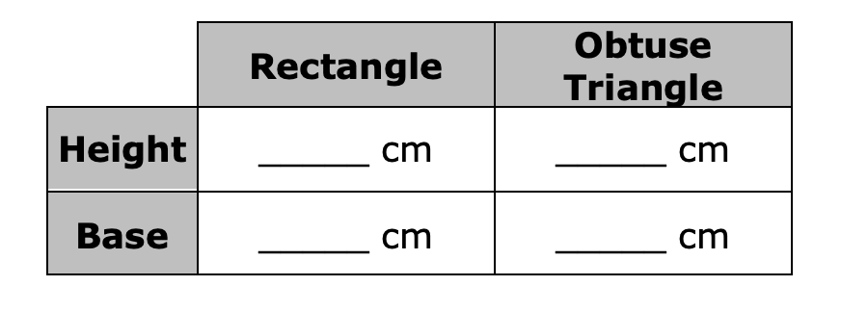
Complete the table.
How many obtuse triangles were needed to create the rectangle?
volume 2, pg. 78

Slide 21
What is the area of the rectangle?
What is the relationship between the area of the rectangle and the obtuse triangle?
e. Based on this relationship, what is the area of the obtuse triangle?
volume 2, pg. 79

Slide 22

Bring It Together
volume 2, pg. 79

Slide 23

8.1.4 Bring It Together: Formula for the Area of a Triangle
Complete the statements
The area of the right triangle was the
area of the rectangle with the same base and height.
The area of the acute triangle was the
area of the rectangle with the same base and height.
half
the same as
half
the same as
volume 2, pg. 79

Slide 24

The area of the obtuse triangle was the
area of the rectangle with the same base and height.
The formula for the area of any rectangle is $A=bh$.
$A=base ∙ height$
The formula for the area of any triangle is $A=________bh$.
$A=______(base ∙ height)$
half
the same as
volume 2, pg. 79

Slide 25

Wrap-Up
volume 2, pg. 80

Slide 26
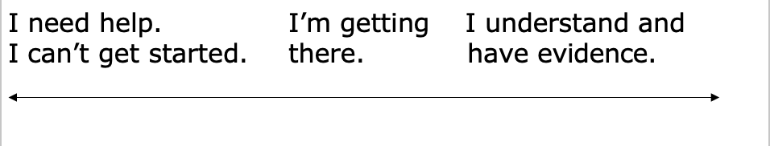
8.1.5 Wrap-Up: Reflection
Place an X on the line to indicate your mastery of today’s lesson.
I can explain why the area of a triangle is half the area of a rectangle with the same base and height for right triangles, acute triangles, and obtuse triangles.
volume 2, pg. 80

Slide 27
Write a brief explanation of your placement of the X.
volume 2, pg. 80

